Slide 1
Customer Churn Prediction & Insights Analysis by
Y. V. Ramana

Slide 2
Objective & Data sets
The goal of the project is to understand why customers stop buying (churn).
We analyze payments, delivery performance, product categories, ratings, and customer repeat behavior.
About data sets
This project uses the Brazilian E-commerce Public Dataset from Olist.
It contains 100,000+ orders from 2016–2018 from multiple online marketplaces.
The dataset includes information about:
Orders & Order Status
Payments & Prices
Delivery & Freight Details
Customer Geolocation
Product Categories
Customer Reviews

Slide 3
Feature Engineering
1. Delivery Performance:
> Categorized orders into: Early, On Time, Late, Very Late
> Result: Very Late deliveries had the highest churn (85.9%)
2. Churn Flag
> Labeled customers as Retained or Churned
Result: Overall churn rate = 71%, repeat customers = 3.12%
3. Average Review Score = 4.08
4. Total Revenue: Added price + freight to compute total revenue

Slide 4
Exploratory Data Analysis (EDA)
To understand customer behavior and business performance, I explored key patterns in the data:
Payment Type Distribution: Most customers use credit cards
Review Score Patterns: Average rating is 4.08
Product Category Performance: 1. Beauty & Health = most orders, 2. Watches & Gifts = highest revenue
Delivery Performance: Late and Very Late deliveries strongly linked to dissatisfaction
Customer Churn Behavior: 71% of customers did not return

Slide 5
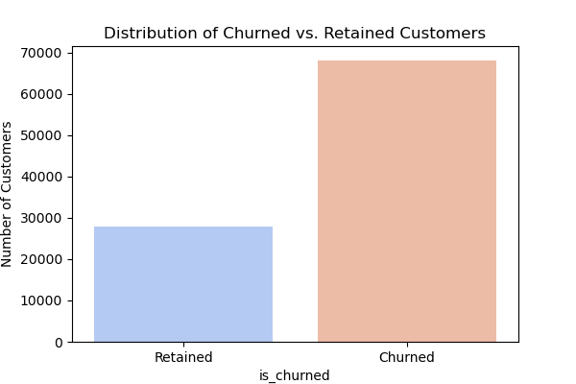
Insight
Churned customers = 71%, Retained = 29%
The business heavily depends on new customers, not repeat buyers.
Customer loyalty is extremely low 3.12
Business Suggestions
Create post-purchase engagement (emails, follow-ups, discount for next order).
Identify high-value customers and target them with retention offers.
Identify high-value customers and target them with retention offers.

Slide 6
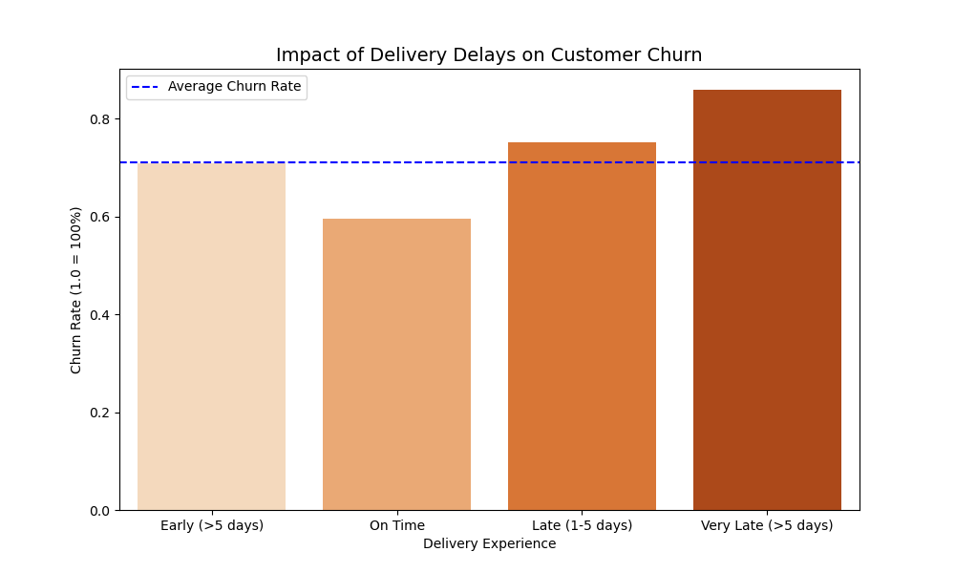
Insights
Churn increases with delivery delay:
*On Time: 59%
*Late (1–5 days): ~75%
*Very Late (>5 days): ~87%
Delivery delay is the 1 driver of churn in your dataset.
Low ratings correlate with late deliveries.
Business Suggestions
Improve logistics partner performance.
Add real-time order tracking for customers.
Set up early warning system for predicted late orders.
Offer automatic apology + coupon for delayed deliveries.

Slide 7
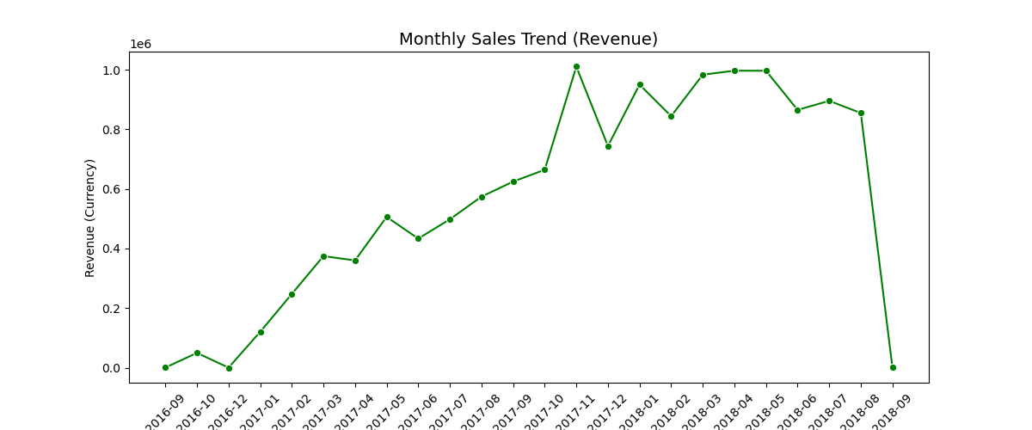
Insights
Clear upward trend in revenue from 2016 to 2018.
Peak revenue months: Nov 2017 – May 2018.
Seasonal spikes show purchases are sensitive to festivals
Business Suggestions
Improve supply chain efficiency to avoid stockouts during peaks.
Increase inventory + marketing during peak months.
Plan seasonal campaigns based on historical peaks.

Slide 8
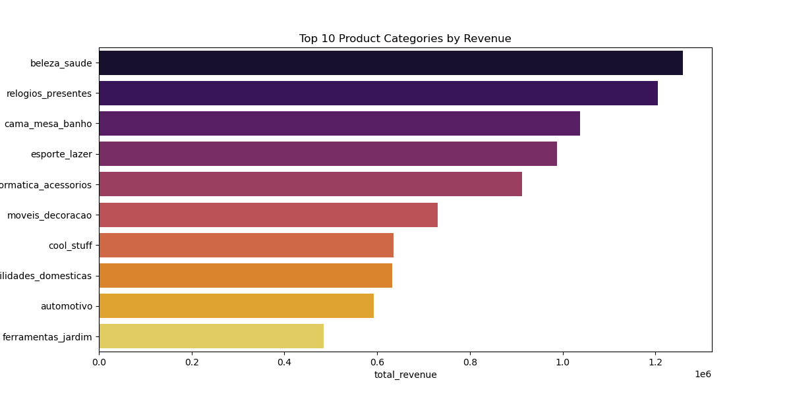
Insights
Beauty & Health → Highest revenue category.
Watches & Gifts → Very strong revenue per unit.
Home & Bath, Sports, Electronics → stable performers.
Low performers: Automotive, Tools, Cool Stuff categories.
Business Suggestions
Increase ads and visibility for top 3 categories.
Bundle low-performing items with high-performing ones.

Slide 9
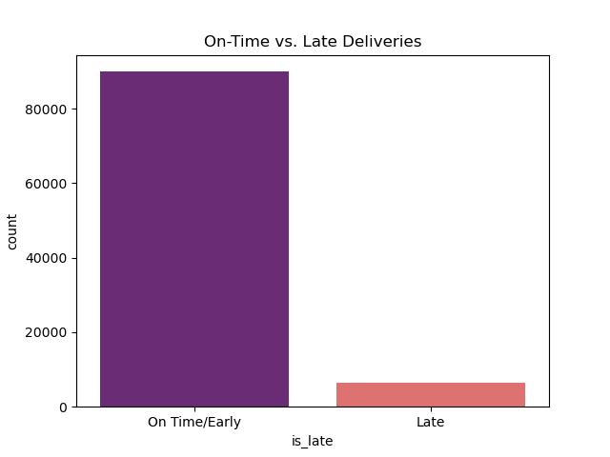
Insights
Majority of orders (90,000+) are delivered On Time or Early.
A smaller portion (7,000+) are delivered Late.
Late deliveries strongly correlate with:Lower review scores, Higher customer churn, More customer complaints
Business Suggestions
Improve logistics partner performance and SLAs.
Use delivery prediction models to flag high-risk delays early.
Maintain buffer stock for high-demand products to avoid shipment delays.
Send real-time delivery updates (WhatsApp/SMS/email).

Slide 10
Unified Business Insights
High churn (71%) → major retention problem.
Delivery delays have the largest negative impact on customer loyalty.
Sales trend shows strong growth: large potential if churn is reduced.
Beauty & Health, Watches & Gifts are top revenue drivers.
Unified Business Recommendations
Improve delivery performance through new logistics SLAs.
Launch loyalty programs to retain customers.
Use predictive churn models to target at-risk customers.
Focus promotions on top-selling categories & improve weak ones.
Provide proactive customer communication during delays.

